Slide 1
Mobile Communication 1G – 5G Evolution
Ravi Mittal
ravi.mittal@iitgoa.ac.in
Indian Institute of Technology, Goa

Slide 2
References
Kurose and Ross, Book, Computer Networking, A Top down approach, 7th Edition
J. Schiller, Book, Mobile Communication, 2008, Pearson
Multiple Internet presentations

Slide 3
We will study..
Why should we know about Mobile Technology?
Limited mobility vs full mobility
Brief History of Mobile Networks
Basic concept – Cellular Networks
2G Network – GSM
3G Network
4G Network – LTE Long Term Evolution
5G Network

Slide 4
Why should we learn about Mobile Technology?

Slide 5
Mobile has become a very important part of our lives
You can reach almost 81% people on the planet Earth with mobile
Extremely low cost – Almost everyone can afford it
Mobile + Internet = Killer Technology for DT

Slide 6
It’s like a magic !
Anyplace in the world, I travel, I receive my calls… can do transactions !
How does it work?
How does it know where I am ?

Slide 7
Let’s learn a little bit about Mobile phone Technology !

Slide 8
Limited Mobility vs Full Mobility

Slide 9
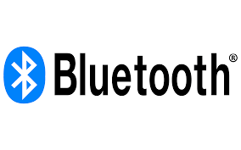

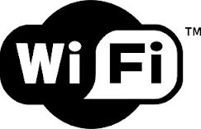
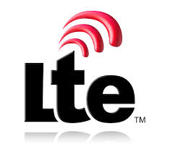
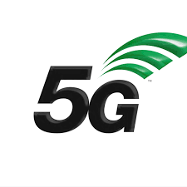


Limited Mobility vs Full Mobility
Limited Mobility
Unlimited Mobility – Cellular Networks
Our Interest

Slide 10
Mobile - Evolution

Slide 11
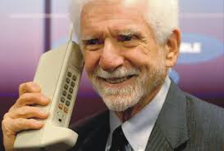
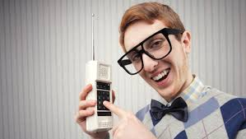
Initial Mobiles – Only for Voice
Remember that initial mobile phones were designed only for calls (voice)

Slide 12
Today’s Mobiles – Millions of Applications
Mobile devices today – A powerful computer that also does voice calls
Support of millions of applications
There are many types of cellular technologies. Let’s first discuss the basics.

Slide 13
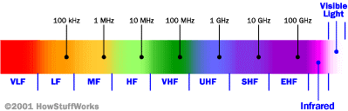
Cellular Network Basics
Cellular networks are based on “Radio Technology”
Radio waves are electromagnetic waves
Your device both generates and receives radio signals
Radio communications are used in many applications
For different applications, frequency ranges are different
Logarithmic scale
Cell phones operate in this frequency

Slide 14
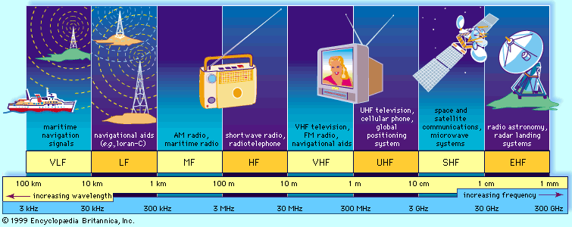
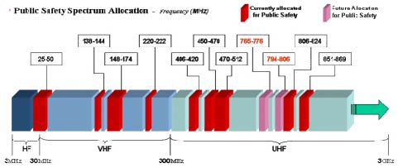
Radio Spectrum
Notes:
FCC allocates spectrum to users – who are these?
Govt. itself (various agencies), military.
Public-safety.
Broadcasters
Telecommunications providers (aka operators) – license holders.
Different bands behave differently …
Most wave propagation properties are frequency/wave-length dependent:

Slide 15
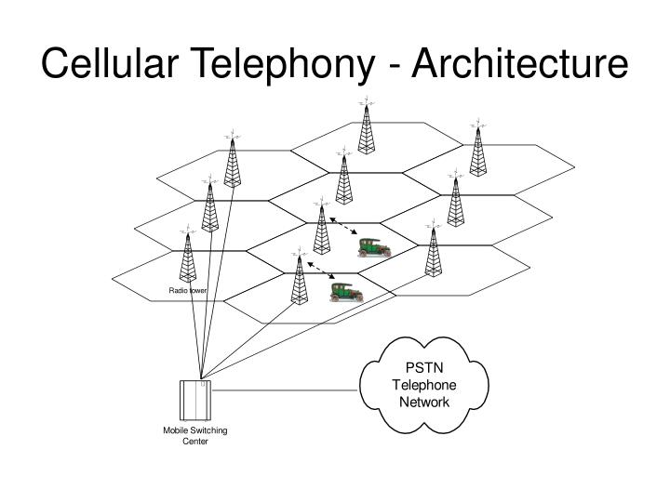

What is a cell?

Slide 16
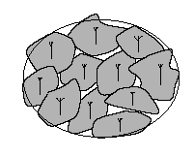
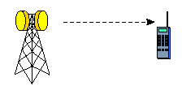
What is a Cell?
Areas divided into cells
Each served by its own antenna
Served by base station consisting of transmitter, receiver, and control unit
Certain channels (e.g. bands of frequencies) allocated to each cell
Cells set up such that antennas of all neighbors are approximately equidistant (hexagonal pattern)
Use multiple low-power transmitters (100 W or less)

Slide 17
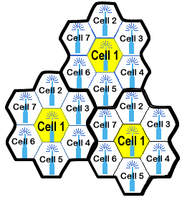
Advantage of Cellular System
Reuse of frequencies in nearby cells
Adjacent cells assigned different frequencies to avoid interference
f₃
f₅
f₂
f₄
f₆
f₅
f₁
f₄
f₃
f₇
f₁
f₂
Cells with the same number (colour) have the same set of frequencies

Slide 18
Advantage/Disadvantages of Cellular System
High Capacity
Less transmission power
Reduced Setup time
Compare this with landline telephone network
Cell size can be changed
Fault tolerance
Robustness against failure of single component
Handover is required
Frequency planning should be good
Spectrum is expensive

Slide 19
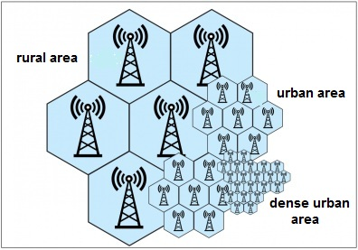
Different cell sizes for Rural and Urban

Slide 20
Cellular Network Evolution: 0G to 5G
0G: Briefcase-size mobile radio telephones
1G: Analog cellular telephony
2G: Digital cellular telephony
3G: High-speed digital cellular telephony (including video telephony)
LTE (4G): IP-based “anytime, anywhere” voice, data, and multimedia telephony at faster data rates than 3G
5G: Enhanced Mobile Broadband (eMBB) – Ultra HD Video, Massive Machine type communication – for smart homes and smart city, Ultra reliable and low latency communication

Slide 21






Mobile Network Evolution
1G
AMPS, NMT
TACS
2G
GSM/GPRS/ EDGE
cdmaOne
3G
WCDMA/HSPA+
CDMA2000/EVDO
TD-SCDMA
4G
LTE
LTE-A
5G
LTE Advance Pro NR
1G 2G 3G 4G 5G
Mid 1980s 1990s 2000s 2010s 2020s
analog
voice
Digital voice
+ Simple data
Mobile
broadband
Mobile Internet
More & faster
Mobile Internet – Ultra High Speed, Low latency, Machine to machine
Notes:
All these are empowered by the evoluation of mobile networks.
Today, the world is advancing to 4G LTE and even LTE advanced.
At this time point, almost everyone knows that 3G/4G mobile networks are everywhere.
This fact can be easily supported by many numbers.
For example, 3G/4G have been deployed in 203 countries; serving 6.8 billions user.
By 2014 (this year), it will go beyond our global population.
Last year, more than half a billion smartphones and tablets are shipped,
The market is $1 trillion by 2016.
And so on…
=========================================================
Mobile network is the largest scale wireless infrastructure.
It covers the whole planet and serves billions of users.
It provides mobile users with data service and carrier-grade quality voice service

Slide 22
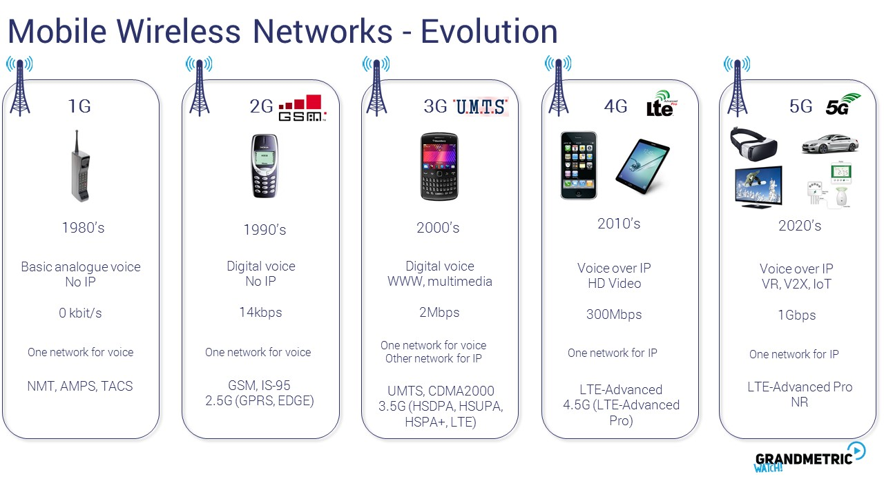

Slide 23
Development of mobile telecommunication systems
CT0/1
FDMA
AMPS
NMT
CT2
IMT-FT
DECT
LTE
advanced
LTE
IS-136
TDMA
D-AMPS
EDGE
IMT-SC
IS-136HS
UWC-136
TDMA
GSM
GPRS
PDC
IMT-DS
UTRA FDD / W-CDMA
HSPA
IMT-TC
UTRA TDD / TD-CDMA
CDMA
IMT-TC
TD-SCDMA
IS-95
cdmaOne
cdma2000 1X
IMT-MC
cdma2000 1X EV-DO
1X EV-DV
(3X)
1G
2G
2.5G
3G
3.9G
4G
5G
Ref: Prof. Dr.-Ing. Jochen H. Schiller

Slide 24
Basic Concept – Cellular Networks

Slide 25
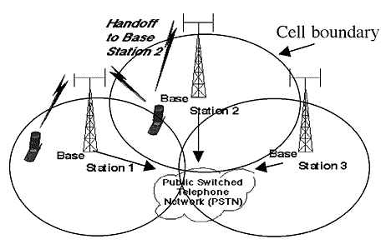
Cellular Network - Basics
Base stations:
Transmit and receive signals from mobiles at given frequency range
Multiple base stations use the same spectrum (spectral reuse)
Each mobile is typically serviced by the nearest base station
Cell: The service area of each base station
f₃
f₅
f₂
f₄
f₆
f₅
f₁
f₄
f₃
f₇
f₁
f₂

Slide 26


Components of cellular network architecture
MSC
connects cells to wired tel. net.
manages call setup
handles mobility
cell
Covers geographical region
base station (BS) analogous to 802.11 AP
mobile users attach to network through BS
air-interface: physical and link layer protocol between mobile and BS
Mobile
Switching
Center
Public telephone
network
Mobile
Switching
Center
wired network
Ref: Computer Networking Book: Kurose and Ross

Slide 27
Cellular networks: the first hop
Two techniques for sharing mobile-to-BS radio spectrum
combined FDMA/TDMA: divide spectrum in frequency channels, divide each channel into time slots
CDMA: code division multiple access
time slots
frequency
bands
Ref: Computer Networking Book: Kurose and Ross

Slide 28
Handoff !
What happens when a user is mobile?
Especially when crossing a cell boundary while continuing the call
Handoff (typically 30 msec
At any time, mobile station (MS) is in one cell and under the control of a BS
When a MS leaves a cell, BS notices weak signal
BS asks surrounding BSs if they are getting a stronger signal
BS transfers ownership to one with strongest signal
new channel is assigned to the MS and it is notified about new boss
Cell 1
Mobile
Telephone
Switching
Center
(MTSC)
Public
Switched
Telephone
Network
(PSTN)
Cell 2
HLR
VLR

Slide 29
2G Network: GSM

Slide 30
2G (voice) network architecture
Base station system (BSS)
MSC
BTS
BSC
G
Public
telephone
network
Gateway
MSC
Legend
Base transceiver station (BTS)
Base station controller (BSC)
Mobile Switching Center (MSC)
Mobile subscribers

Slide 31
GSM Architecture
OMC, EIR, AUC
HLR
fixed network
NSS (Network Switching
System with OSS
(Operational Support
System)
GMSC
VLR
MSC
VLR
MSC
BSC
BSC
RSS: Radio
Subsystem
OMC: Operations and Maintenance center
EIR: Equipment Identity Register
AUC: Authentication Center

Slide 32
GSM Components - BTS
Transmits and receives signals to/from Mobile Stations
Coverage Area depends on
Transmitting Power of the BTS
Transmitting power of the mobile station (user devices)
Height of the base station antenna
Obstructions – tall buildings etc
BTS is in the middle of the cell
Uses FDM/TDM communication

Slide 33
GSM Components – BSC and MSC
Base Station Controller (BSC)
Services tens of BTSs
Role
To allocate BTS radio channels to mobile subscribers (mobile phone)
Performing paging – Finding the cell in which the mobile user is resident
Performing handoff
Base Station Subsystem
BSC + set of BTSs
Mobile Switching System (MSC)
User authorization and Accounting
Call establishment and teardown
Handoff management
A cellular provider’s network has multiple MSCs
Gateway MSCs – connect to larger public telephone network

Slide 34
GSM Components – HLR, VLR
Databases
Home Location Register (HLR)
Central master database containing user data, permanent and semi-permanent data of all subscribers assigned to the HLR
One provider can have several HLRs
Visitor Location Register (VLR)
Local database for a subset of user data, including data about all user currently in the domain of the VLR

Slide 35
Mobile Terminated Call
1: calling a GSM subscriber
2: forwarding call to GMSC
3: signal call setup to HLR
4, 5: request MSRN from VLR
6: forward responsible (destn) MSC addr to GMSC
7: forward call to
current MSC
8, 9: get current status of MS
10, 11: paging of MS
12, 13: MS answers
14, 15: security checks
16, 17: set up connection
4
HLR
VLR
5
8
9
3
6
14
15
calling
station
7
PSTN
GMSC
MSC
1
2
10
10
13
10
16
BSS
BSS
BSS
11
11
11
11
12
17
MS
MSRN: Mobile Station Roaming Number – Assigned by visitor-network to mobile
when it roams in another area. It is stored in HLR.

Slide 36
Performance characteristics of GSM (wrt. analog sys.)
Communication
mobile, wireless communication; support for voice and data services
Total mobility
international access, chip-card enables use of access points of different providers
Worldwide connectivity
one number, the network handles localization
High capacity
better frequency efficiency, smaller cells, more customers per cell
High transmission quality
high audio quality and reliability for wireless, uninterrupted phone calls at higher speeds (e.g., from cars, trains)
Security functions
access control, authentication via chip-card and PIN

Slide 37
2G limitations
No Internet (Data) connectivity
In 2.5G Network, GPRS for data communication was introduced

Slide 38
1G to 3G
Enabling Technologies
3G
2 Mbps
CDMA Migration
CDMA2000
3XRTT
(UMTS)
1G-2G Migration
W-CDMA
(UMTS)
500 kbps
TDMA Migration
2.5G
EDGE
150 Kbps
CDMA-2000
1XRTT
100 Kbps
GPRS
2G
50 Kbps
10 Kbps
1G
IS-95
GSM
1 Kbps
AMPS
1980
1999
2000
2001
2002
2003

Slide 39
GSM Evolution to 3G
High Speed Circuit Switched Data
Dedicate up to 4 timeslots for data connection ~ 50 kbps
Good for real-time applications c.w. GPRS
Inefficient -> ties up resources, even when nothing sent
Not as popular as GPRS (many skipping HSCSD)
Enhanced Data Rates for Global Evolution
Uses 8PSK modulation
3x improvement in data rate on short distances
Can fall back to GMSK for greater distances
Combine with GPRS (EGPRS) ~ 384 kbps
Can also be combined with HSCSD
GSM
9.6kbps (one timeslot)
GSM Data
Also called CSD
HSCSD
GSM
GPRS
WCDMA
General Packet Radio Services
Data rates up to ~ 115 kbps
Max: 8 timeslots used as any one time
Packet switched; resources not tied up all the time
Contention based. Efficient, but variable delays
GSM / GPRS core network re-used by WCDMA (3G)
EDGE

Slide 40
3G Network

Slide 41
3G (voice+data) network architecture
MSC
G
Public
telephone
network
radio
network
controller
Gateway
MSC
G
Public
Internet
SGSN
GGSN
radio interface
(WCDMA, HSPA)
radio access network
Universal Terrestrial Radio
Access Network (UTRAN)
core network
General Packet Radio Service
(GPRS) Core Network
public
Internet
SGSN: Service GPRS Support Node
GGSN: Gateway GPRS Support Node

Slide 42
3G Network
Based on consideration of use of existing 2G infrastructure
Add parallel infrastructure for data communication
Evolved version of GPRS
It uses Direct Sequence Widespread CDMA within TDMA slots
Data Services associated with WCDMA specification are known as HSPA (High Speed Packet Access)
Downlink speed : up to 14 Mbps

Slide 43
3G (voice+data) network architecture
Serving GPRS support Nodes (SGSNs)
Responsible for delivering packets to/from the mobile nodes in the radio access network to which SGSN is attached
SGSN interacts with MSC for that area providing
User authorization, handoff
Maintaining user location (cell) information about active mobile nodes
Forwards packets between mobile nodes and GGSN
Gateway GPRS Support Nodes (GGSNs)
Acts as a Gateway
Connects multiple SGSNs to the larger Internet
For outside world, GGSN looks like any other gateway router
Mobility of the 3G mobile nodes within GGSN is hidden from the outside world
GPRS: Generalized Packet Radio Service

Slide 44
3G (voice+data) network architecture
3G standard: UMTS (Universal Mobile Telecommunication Service(
Radio Network Controller (RNC)
Controls several cell base transceiver stations (BTSs)
Connects to circuit switched voice network via MSC
Connects to packet switched Internet via SGSN
Common first/last hop radio access network
3G UMTS uses CDMA technique known as – Direct Sequence Wideband CDMA (DS-WCDMA)
The data service – HSP (High Speed Packet Access)
Downlink data rate – 14 Mbps

Slide 45
4G Network

Slide 46
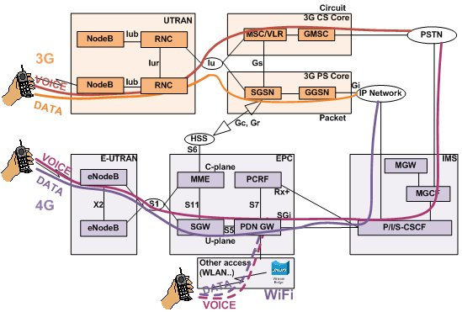
3G vs 4G
3G and earlier maintains two data paths
Circuit switched: Phone calls (8kbps) and SMS/MMS
Packet switched: All IP data

Slide 47
3G vs 4G
4G - LTE uses “all in one” approach
Everything over IP, including voice
S-GW (Serving Gateway) replaced SGSN, P-GW replaces GGSN

Slide 48
3G versus 4G LTE network architecture
MSC
G
Public
telephone
network
3G
radio
network
controller
Gateway
MSC
G
Public
Internet
SGSN
GGSN
4G-LTE
HSS
MME
G
G
Public
Internet
S-GW
P-GW
radio access network
Universal Terrestrial Radio
Access Network (UTRAN)
Evolved Packet Core
(EPC)

Slide 49
4G: differences from 3G
All IP core: IP packets tunneled (through core IP network) from base station to gateway
no separation between voice and data – all traffic carried over IP core to gateway
Separate control plane and data plane
Mobility
Management
Entity (MME)
Home Subscriber
Server(HSS)
(like HLR+VLR)
Serving
Gateway
(S-GW)
Packet data
network
Gateway
(P-GW)
UE
(user element)
eNodeB
(base station)
HSS
MME
control
G
G
Public
Internet
data
S-GW
P-GW
radio access network
Universal Terrestrial Radio
Access Network (UTRAN)
Evolved Packet Core
(EPC)

Slide 50

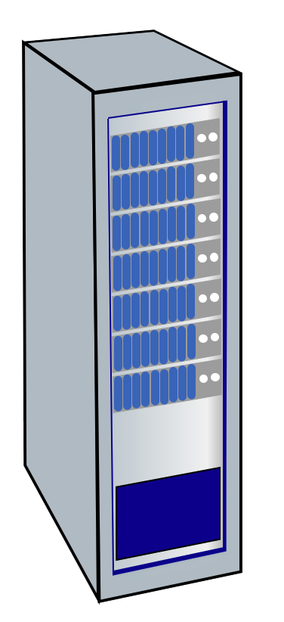




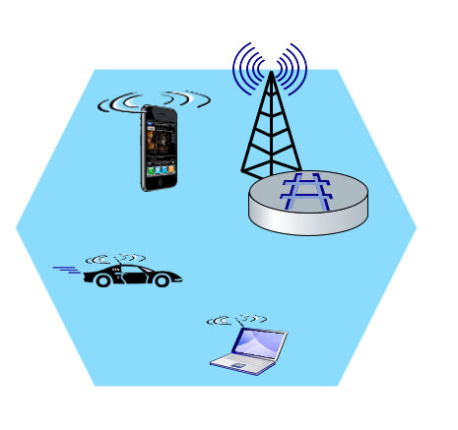
Elements of 4G LTE architecture
Mobile device:
smartphone, tablet, laptop, IoT, ... with 4G LTE radio
64-bit International Mobile Subscriber Identity (IMSI), stored on SIM (Subscriber Identity Module) card
LTE jargon: User Equipment (UE)
Mobility Management Entity (MME)
Home Subscriber Service (HSS)
Mobile device
(UE)
Base station
(eNode-B)
to
Internet
PDN gateway (P-GW)
…
Serving Gateway (S-GW)
radio access
network
all-IP Enhanced Packet Core (EPC)
OFDM: Orthogonal Frequency Division Multiplexing

Slide 51
Elements of 4G LTE architecture
Base station:
at “edge” of carrier’s network
manages wireless radio resources, mobile devices in its coverage area (“cell”)
coordinates device authentication with other elements
similar to WiFi AP but:
active role in user mobility
coordinates with nearly base stations to optimize radio use
LTE jargon: eNode-B
Mobility Management Entity (MME)
Home Subscriber Service (HSS)
Mobile device
(UE)
Base station
(eNode-B)
to
Internet
PDN gateway (P-GW)
…
Serving Gateway (S-GW)

Slide 52
Elements of 4G LTE architecture
Home Subscriber Service
stores info about mobile devices for which the HSS’s network is their “home network”
works with MME in device authentication
Mobility Management Entity (MME)
Home Subscriber Service (HSS)
Mobile device
(UE)
Base station
(eNode-B)
to
Internet
PDN gateway (P-GW)
…
Serving Gateway (S-GW)

Slide 53
Elements of 4G LTE architecture
Serving Gateway (S-GW), PDN Gateway (P-GW)
lie on data path from mobile to/from Internet
P-GW
gateway to mobile cellular network
Looks like nay other internet gateway router
provides NAT services
other routers:
extensive use of tunneling
Mobility Management Entity (MME)
Home Subscriber Service (HSS)
Mobile device
(UE)
Base station
(eNode-B)
to
Internet
PDN gateway (P-GW)
…
Serving Gateway (S-GW)

Slide 54
Elements of 4G LTE architecture
Mobility Management Entity
device authentication (device-to-network, network-to-device) coordinated with mobile home network HSS
Mobility Management Entity (MME)
Home Subscriber Service (HSS)
Mobile device
(UE)
Base station
(eNode-B)
to
Internet
PDN gateway (P-GW)
…
Serving Gateway (S-GW)
mobile device management:
device handover between cells
tracking/paging device location
path (tunneling) setup from mobile device to P-GW

Slide 55
5G Network

Slide 56
On to 5G!
Goal: 10x increase in peak bitrate, 10x decrease in latency, 100x increase in traffic capacity over 4G
5G NR (new radio):
two frequency bands: FR1 (450 MHz–6 GHz) and FR2 (24 GHz–52 GHz): millimeter wave frequencies
MIMO: multiple directional antennae
Millimeter wave frequencies: much higher data rates, but over shorter distances
pico-cells: cells diameters: 10-100 m
massive, dense deployment of new base stations required

Slide 57
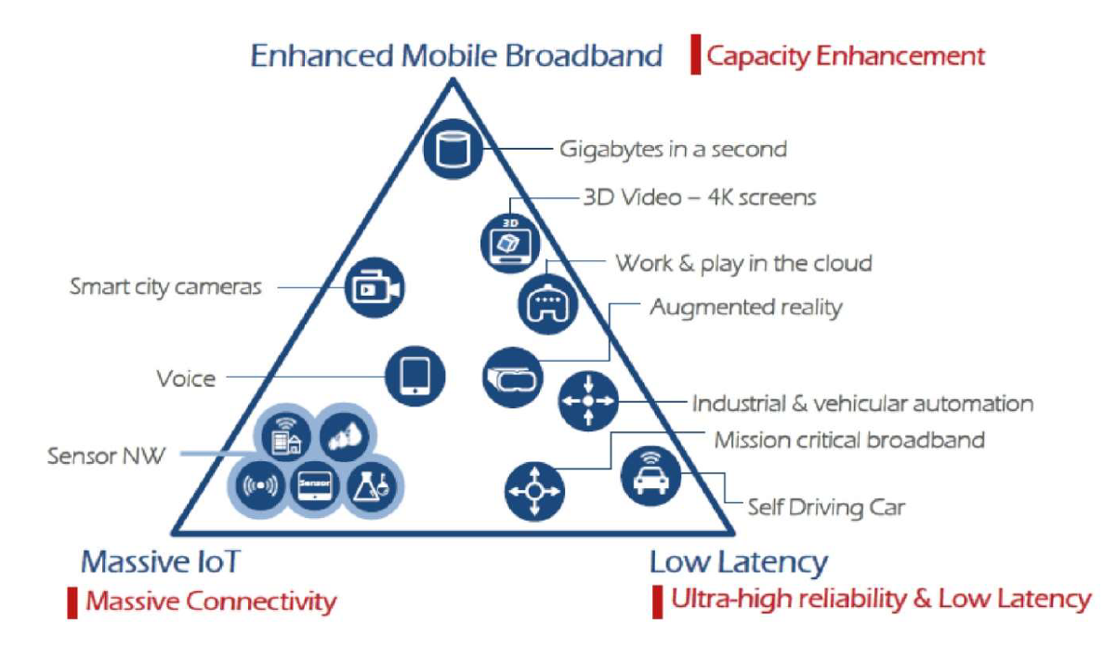
https://www.itu.int/dms_pubrec/itu-r/rec/m/R-REC-M.2083-0-201509-I!!PDF-E.pdf

Slide 58
5G use cases
Massive Machine-to-Machine (M2M) communication
Support for billions of IoT devices
Ultra Reliable low latency communication
Support for mission critical real-time communication
Safety systems
Autonomous Driving
Industrial Robotics
Etc
Enhanced Mobile Network
High Data Speed
Peak data rates up to 20 Gbps

Slide 59
Lecture Summary
Mobile Technology has changed the world of Telecommunication
Along with Internet, it has caused significant digital penetration
With 5G Technology, end users will be able to use highspeed data (Internet) communication with very low delays
It will allow massive machine to machine communications – required for IoT

